Slide 1
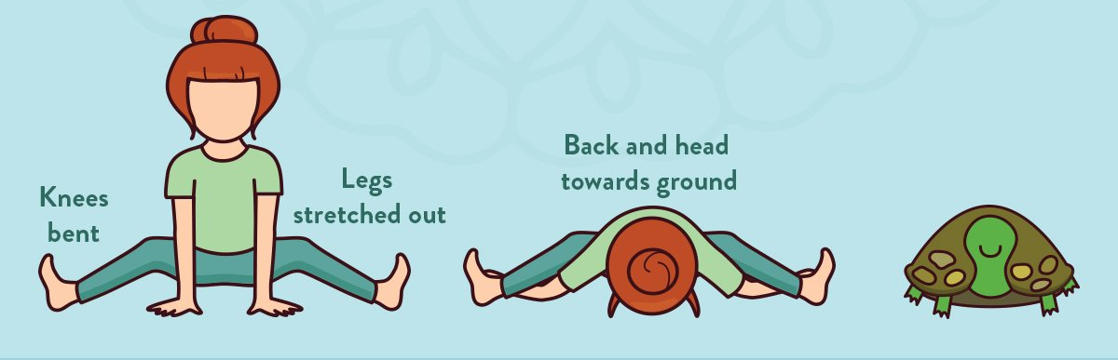
#WELLNESS WEDNESAY
STRETCH & REFLECT
Turtle Stretch
Sit on your bottom with your knees bent and your feet flat on the floor. Then take your feet out wide and be sure you are sitting with a tall, straight spine. Slide your arms under your knees and place your hands flat on the floor outside your legs. Bend forward, keeping your back and neck straight. Hold for 30 seconds. While you hold, think about how a little progress each day adds up to big results.
Practice every day to see if you can bend further forward or increase the length of time you can hold your stretch.
Show us your stretch!
@KnowsleySSP
#WellnessWednesday
#MerseysideSGO

